Slide 1
Mini Project
Rapid transit & Neighborhoods
Initial idea: compare between different cities (NYC, Boston) and see performance of public transport differs by demographics.
Problem: Different measures and format of train performance and time periods between train systems.
Question: Does MBTA service performance vary significantly across socioeconomically diverse neighborhoods? Station-level study of public transit equity in Massachusetts.

Slide 3
Datasets
Datasets:
https://www.census.gov/
https://gis.data.mass.gov/search
Problems:
Current performance data is provided based on routes, not stations.
One route can go through many neighborhoods, with different demographics.
Solution: use all train records and calculate performance (wait time, reliability) by station and join with census tract data

Slide 4
Data Retrieval
Neighborhood characteristics (by census tract): median income, % college students, % people using public transit, % White population, Total population with no vehicle
Headway (Frequency) = average time in between first train arrival and its following arrival
This shows average time a person need to wait to get on a train at specific station.
Reliability (Consistency) = standard deviation of headway
Is wait time in between trains predictable or very inconsistent?

Slide 5
Data Cleaning
Before
235 geoIDs (census tracts around MA) with aggregated level of demographic characteristics
170 MBTA stations
2,535,587 rows of train records within October 2025 (DEP/ARR each day for all train trips)
After
Only take heavy + light rails trains log of October 2025 for regression (typical month - no holidays or weather disruptions).
Spatial join: Final 71 stations with corresponding station-level data and census tract info that the station is in.

Slide 6
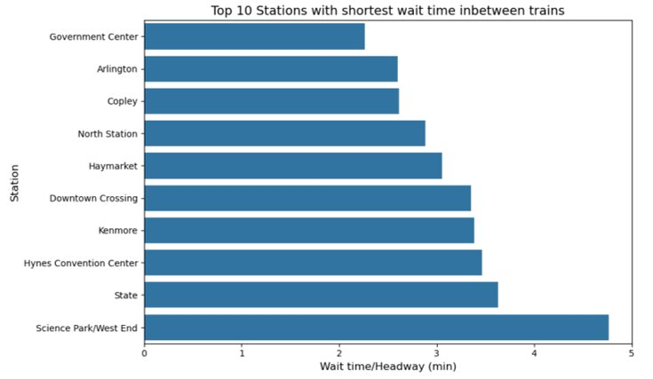
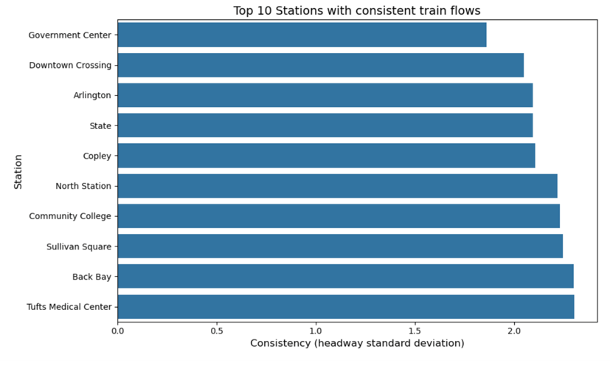
Top 10 performance

Slide 7
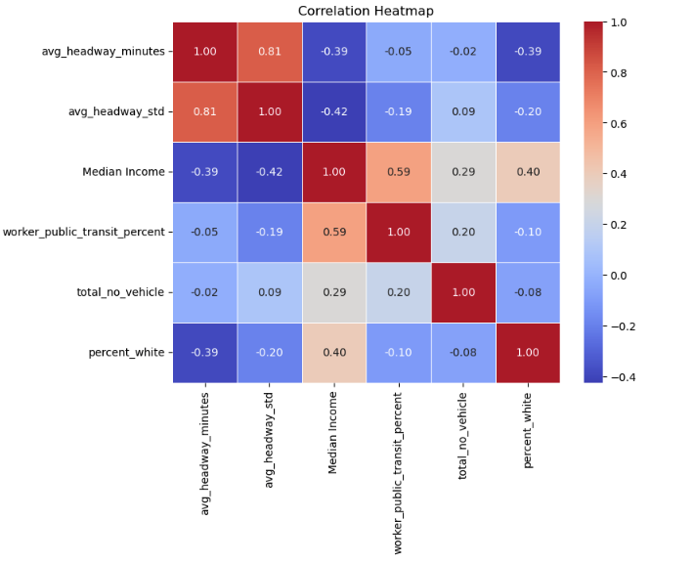
Correlations

Slide 8
Linear Regression results
y1 = Train frequency (minutes)
Mean Squared Error: 0.85014
R-squared: 0.3960
y2 = Station reliability (standard deviation of wait times)
Mean Squared Error: 3.7512
R-squared: 0.4714
For both models, median income is more important factor (high coefficient)

Slide 9
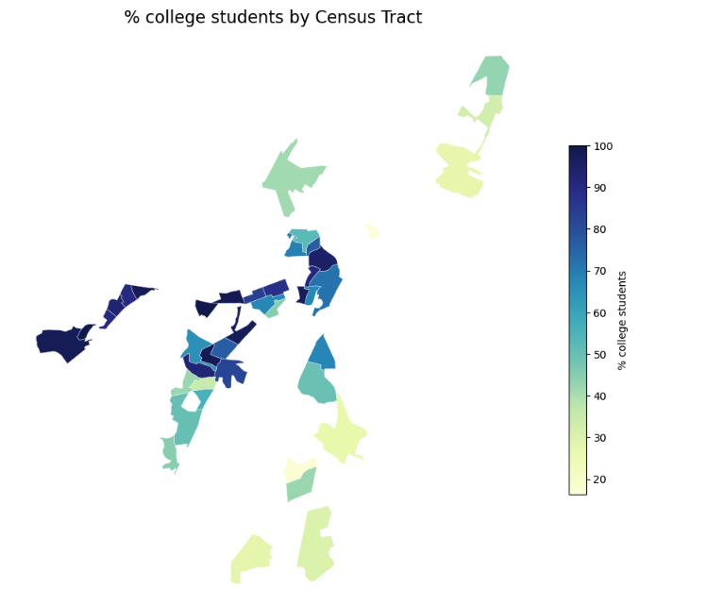
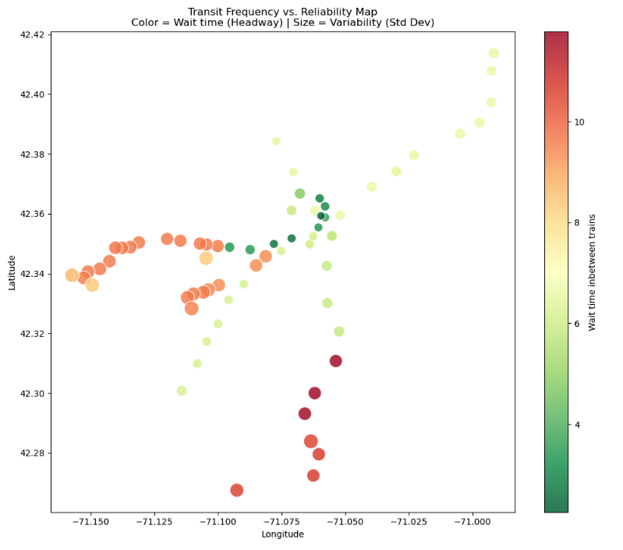
Student population & Train frequency/station reliability

Slide 10
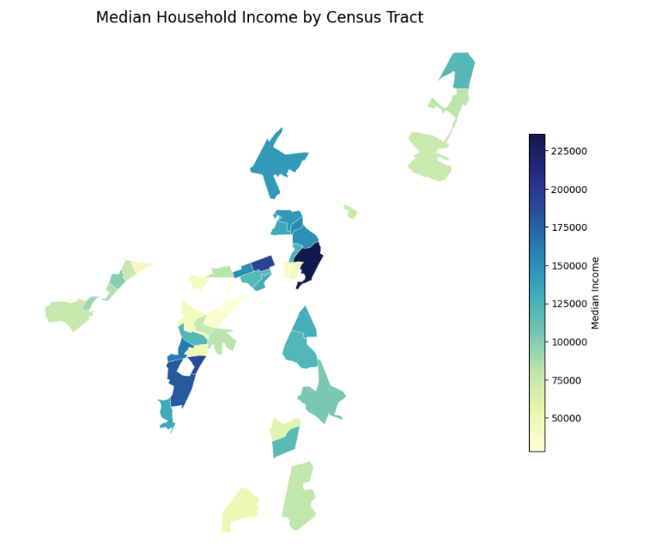
Income & Train frequency/station reliability

Slide 11
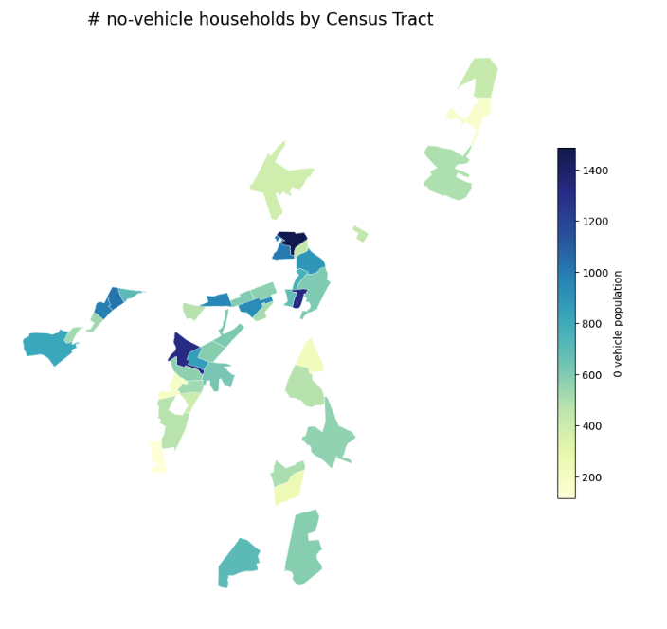
Public transit dependents & Train frequency/station reliability

Slide 12
Implications for stakeholders
Urban/MBTA planners:
Evidence for the need to improve quality of stations, not just the route itself.
Access to transportation is important, but quality should also be taken into account.
New perspective on performance of trains: coverage-based to performance-based approach.

Slide 13
Ethical, legal, societal implications
Only rapid transit lines (Red, Blue, Orange, Green) are used to compare between neighborhoods. Those data is often more stable than buses, but less representative of all public transit used.
Current result works as a general test of operations between stations and neighborhoods differences.
Ethical & legal implications:
Data is extracted from one 'typical' month to run regression and aggregated to see overall average. Therefore, it is prone to noise.
Performance = Equity audit using socioeconomic data.
Assess transparency of performance by locations, not just by route.

Slide 14
Next steps
Add insights of wait times/reliability of other types of public transit to understand the nature of transportation across neighborhoods.
Look at delayed/scheduled data by stations.
Evaluate based on time of the day to see impact of rush hours?
Look at different years, is the Service Equity Policy as effective as MBTA claimed to be?

